Slide 1
Deploy Infrastructure and Automate using
Iac
Group Project:05

Slide 2
Team Members
Atharv Pawar 240340127034
Devendra Raut 240340127038
Atish Sawant 240340127035
Shubham Mishra 240340127007

Slide 3
Objective
To Deploy Infrastructure and Automate Deployment using IaC

Slide 4
Features of Terraform
Plan and Apply:
Offers a two-step process (terraform plan and terraform apply). The plan command shows a preview of what changes will be made, while the apply command executes those changes. This feature helps prevent unintended modifications to infrastructure.
State Management:
Maintains a state file that tracks the current state of your infrastructure. This state file allows Terraform to determine what changes need to be applied to match the desired state. This feature is crucial for managing complex infrastructure.

Slide 5
Features of EKS
Scalability:
EKS allows you to scale your applications dynamically based on demand
Managed Node Groups:
EKS provides managed node groups that automatically provision and manage EC2 instances in your cluster, simplifying the process of scaling worker nodes.
Simplified Kubernetes Management:
EKS automates the provisioning, scaling, and management of the Kubernetes control plane, including the underlying infrastructure like EC2 instances, networking, and storage.

Slide 6
Workflow
Terraform Installation
Jenkins Installation
AWS IAM User Creation
AWS Key Pair Creation
SSH Key creation for VMware Instance use
Terraform separates files for EKS, Nodes, VPC, Providers, IAM, Security Groups
Github Personal Access Token
Git Repository of Terraform files

Slide 7
Future Scope
Automating Deployments
Integrate Jenkins to automate the deployment process for EKS clusters, ensuring seamless and consistent updates to the environment.

Slide 8
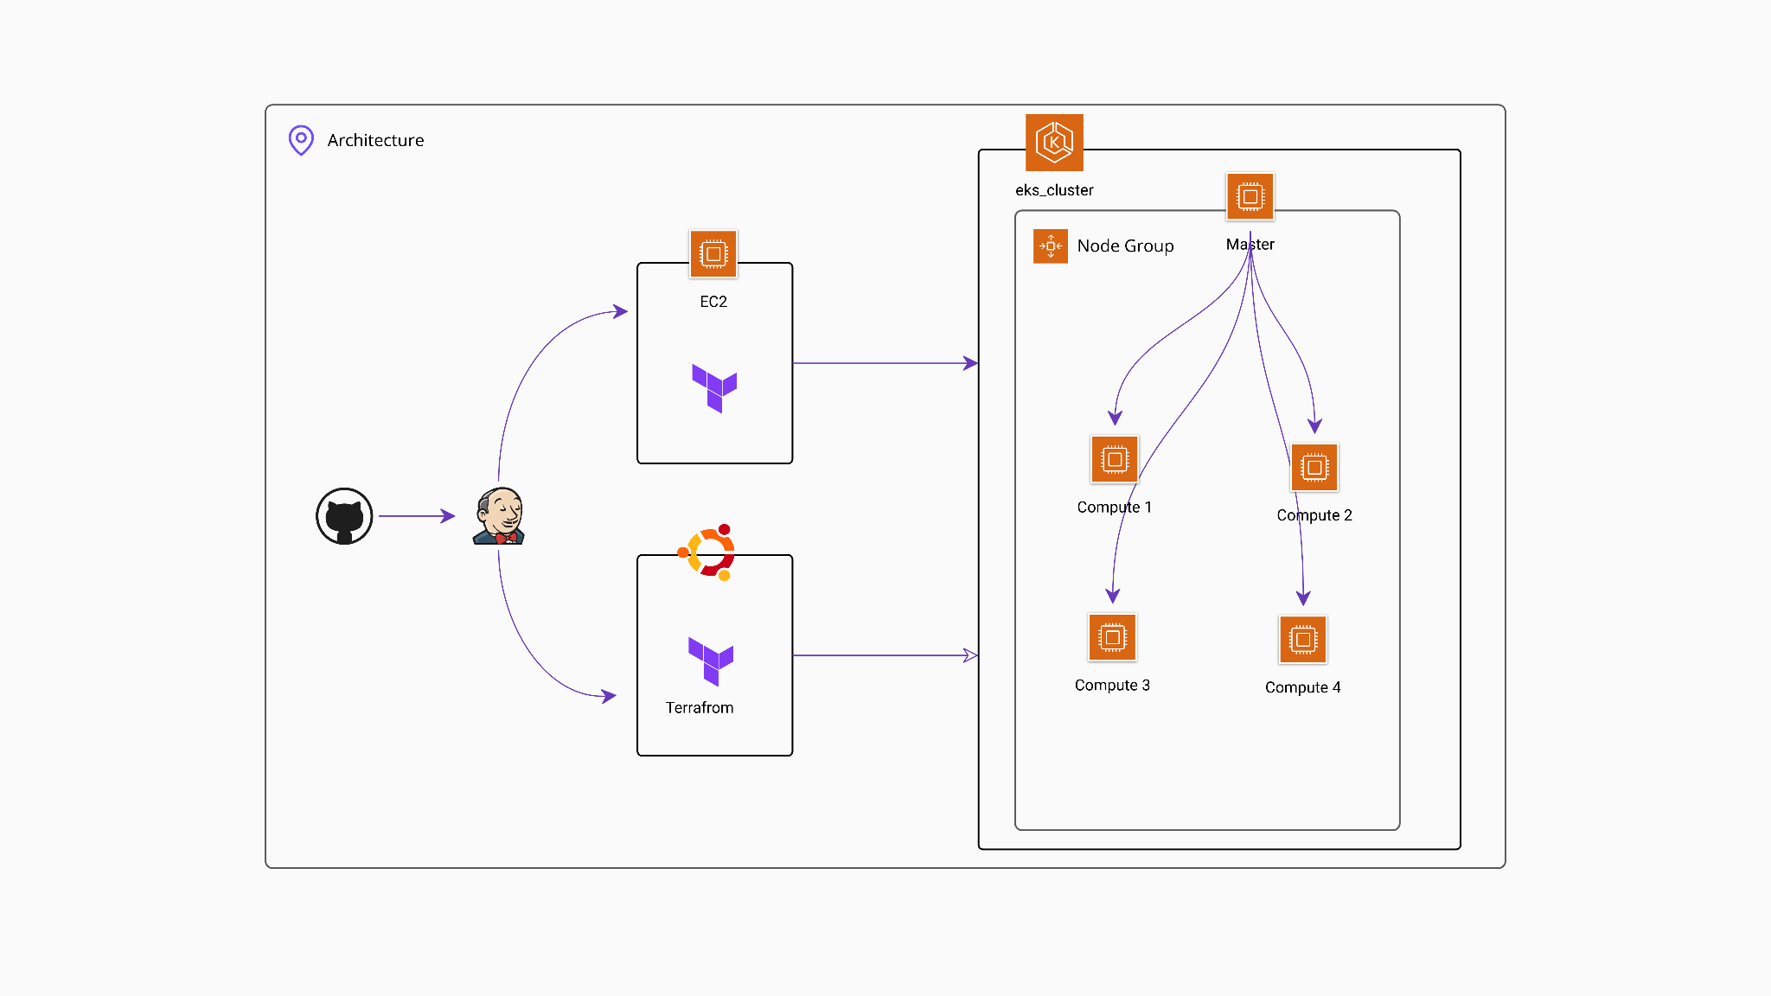
Architecture

Slide 9
Thank You!

